Slide 1
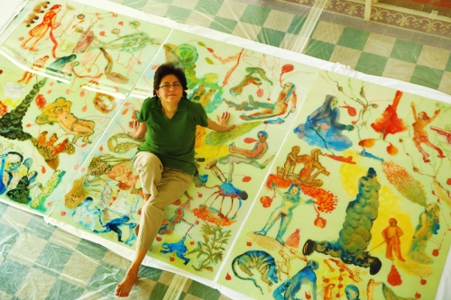
NALANI MALANI

Slide 2
ABOUT NALANI MALANI
Nalini Malani began experimenting with video art at a point when it was an obscure art form in India. Her inspirations are personal, as well as historical and cultural. She incorporates paintings, videos, installation, and wall art to provide various layers to cultural conflicts and resistance through her art works.

Slide 3
INSPIRATION
influenced by her experiences as a refugee of the Partition of India
She places inherited iconographies and cherished cultural stereotypes under pressure.

Slide 4
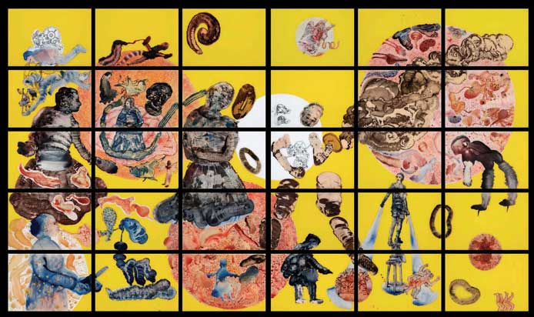
paintings
Cassandra 30 panel polytych, acrylic, ink and enamel reverse painting on acrylic sheet, 227.5 x 396 cm, 2009

Slide 5
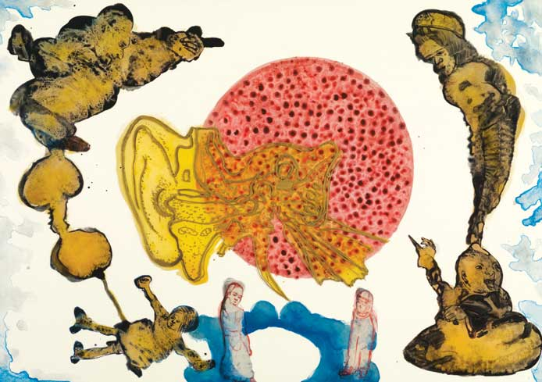
Listening to the Shades 7 Acrylic, ink and enamel reverse painting on acrylic sheet, 2008

Slide 6
videos
http://www.nalinimalani.com/video.htm

Slide 7
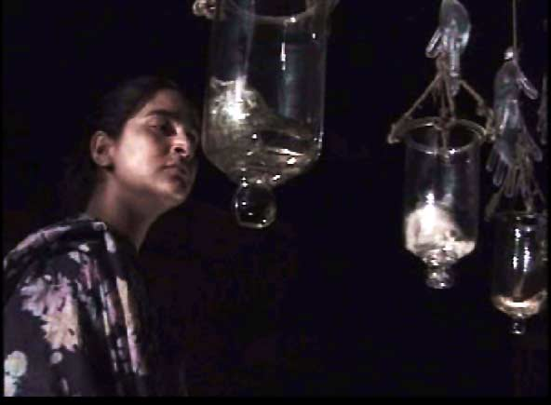
installations
The Job / Naukari Theatre, Installation, Video, 1997

Slide 8
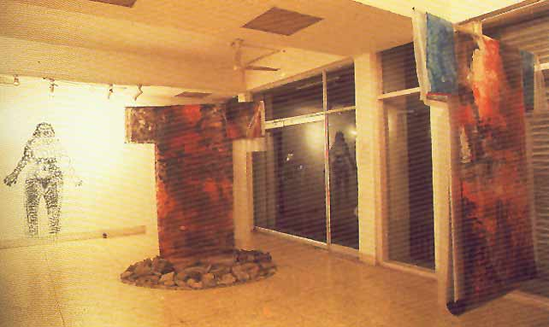
installations
Medea installation Paintings, Installation, Books, Theatre, Video 1991 – 1996

